Slide 1
JS Essentials & JS Behind the Scenes

Slide 2
Agenda
DOM Manipulation
Events
Functions Constructor
Prototype
Object.create()
IIFE ( Immediately Invoked Function Expression)
Closures
Call, Apply and Bind
Event Loop

Slide 3
DOM (Document Object Model)
Structured representation of HTML Document. Allows Javascript to access HTML elements and styles in order to manipulate them.
DOM is automatically created by the browser as soon as HTML page load.
It is stored in a tree structure
Each HTML element in DOM is an object
Apart from HTML element, even text and html comments are available in DOM as nodes
Note: DOM is not a part of JS language. It is a part of Web APIs
Web APIs - Timers (setTimeout,setInterval), fetch, history API etc

Slide 4
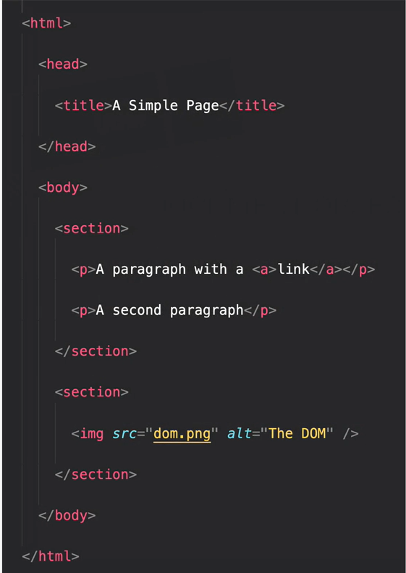
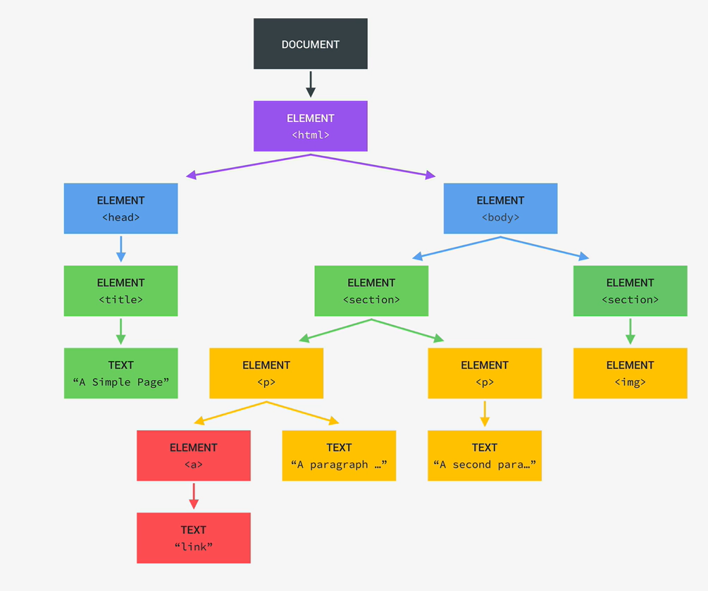
The DOM Tree Structure
Tree structure generated by browser on page load

Slide 5
DOM Continue...
document is an object we have available in javascript which is used to play around with DOM
Various methods are available in document object. Ex querySelector,getElementById etc
It is stored in a tree structure
Each HTML element in DOM is an object

Slide 6
Selecting HTML elements
document.getElementById(‘id of the element’)
document.getElementsByClassName(‘class of the element’)
document.getElementsByTagName(‘button)
document.querySelector(‘any css selector’)
Returns just the first occurrence of element
document.querySelectorAll(‘any css selector’)
Returns all the occurrences of element in array
document.documentElement, document.head, document.body
Note: methods for selecting elements are not only available on the document object but also on the element itself. That means it is possible traverse the child elements of particular element using above mentioned methods.

Slide 7
Difference between querySelector and getElements method
querySelector methods return NodeList while getElement methods return HTMLCollection.
HTMLCollection is live collection meaning if DOM changes happen then it would reflect in HTMLCollection but won’t be reflected in NodeList.
NodeList and HTMLCollection are array like objects but they are not exactly the same as array.
For loop and for of loop can be used on these but other array methods like map, reduce, filter are not available. To use these methods we can convert nodeList and HTMLCollection to array first using Array.from() and spread operator.

Slide 8
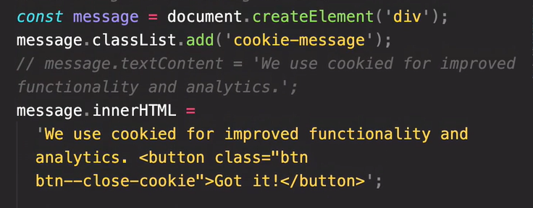
Creating element

Slide 9
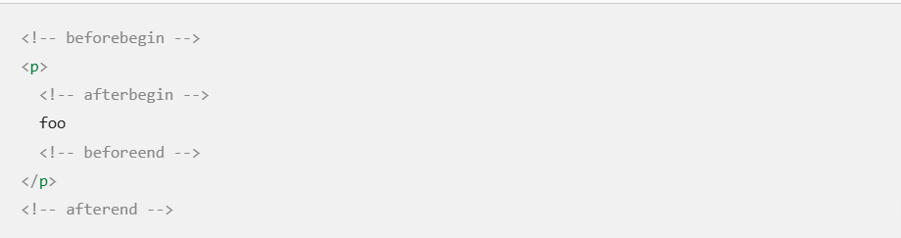
Inserting Elements
element.insertAdjacentElement(position, newElement);
element.insertAdjacentHTML(position, htmlString);
Positions

Slide 10
Inserting Elements Cont..
element.prepend(newElement);
– inserts the element as first child
element.append(newElement);
– inserts the element as last child
element.before(newElement)
– inserts the element as adjacent sibling just before the target element
element.after(newElement)
– inserts the element as adjacent sibling just after the target element
Note: you cannot add the same element at multiple different positions.
I.e if element is added to DOM using prepend and later same element is added using append then element will move from being the first child of element to being the last child of element
To add the same element at different position we can use element.cloneNode(true) to first make the copy of element and then add to different position

Slide 11
Deleting element from DOM
element.remove() — new way
element.parentElement.removeChild(element) — older way

Slide 12
Accessing & Adding Styles to Element
element.style.width = ‘60%’
element.style.backgroundColor=’red’
Styles added this way are directly added to DOM element as inline styles.
Note:
If we try to access styles of element using above mentioned way then we can only get those styles which are applied as inline but we won't be able to get styles which are added from stylesheet
To get those styles we have to make use of getComputedStyle(element) method

Slide 13
Accessing and adding Attributes
For standard attributes like class, alt, src
element.attributeName will return the attribute value
element.attributeName = ‘ value’ will change/set the attribute value
For non standard attributes
element.getAttribute(‘src’) will return the attribute value
element.setAttribute(‘src’,’/logo’) will change/set the attribute value
Data attributes
<p data-version-no=”1.2”>1.2</p>
element.dataset.versionNo

Slide 14
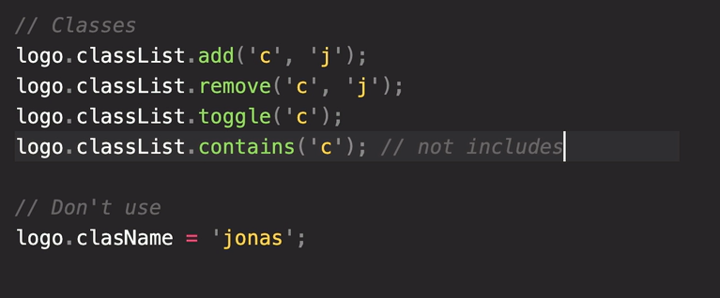
HTML Element Classes

Slide 15
Manipulating HTML elements
document.getElementById(‘id of the element’).textContent = ‘hello’
document.getElementById(‘id of the element’).value = 40
document.getElementById(‘id of the element’).innerHtml

Slide 16
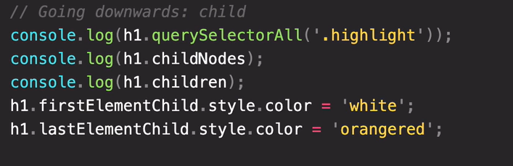
DOM Traversing
It basically means walking through the DOM that means selecting an element based on another element
Going Downwards

Slide 17
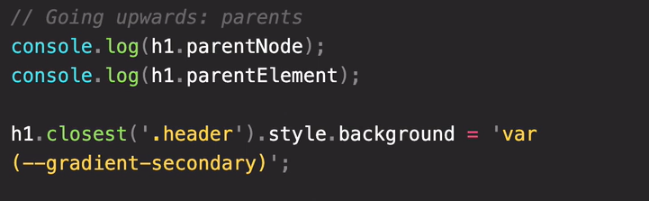
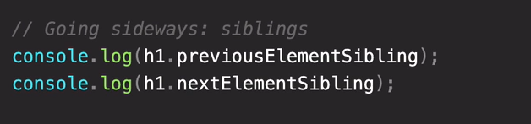
DOM Traversing Cont.
Going Upwards

Slide 18
Events
element.onclick = function (e) {
…
}
Downside - can’t define multiple listeners to event with this method. Can’t remove listeners.
element.addEventListener(‘click’,function_name)
element.addEventListener(‘click’,function_name2)
Multiple listeners can be added with this method
Listeners can be removed using element.removeListener(‘click’,function_name)

Slide 19
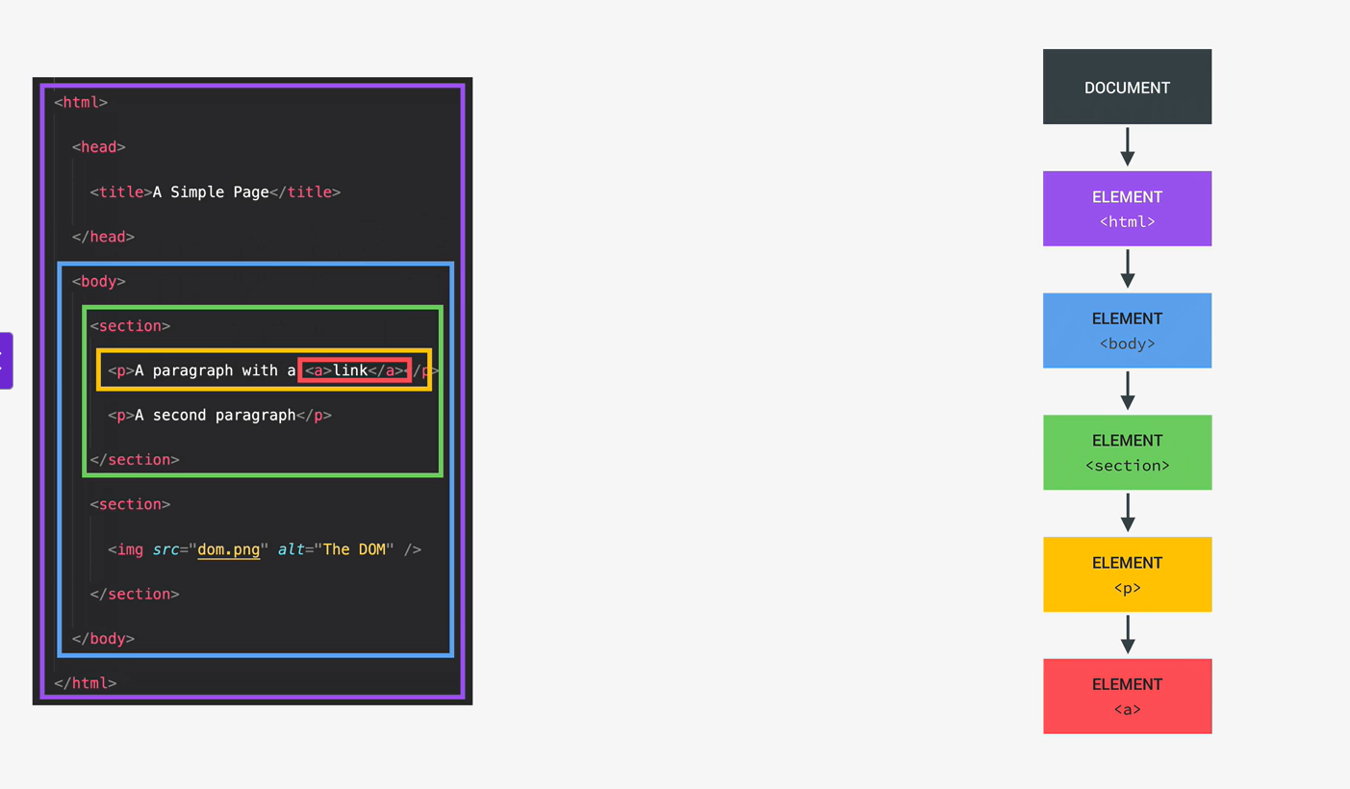
Event Bubbling And Capturing

Slide 20
Event bubbling and capturing
If any anchor tag is clicked then the click event is not actually generated at the target element (<a> tag) but it is generated at root level that is document from there it goes down passing through all the parent elements of that target element. This phase of event is called event capturing.
After this the event then again goes back to the root level passing through each parent element of target. This phase is called event bubbling.
By default event capture phase is disabled and event travels up the parent in bubbling phase.
To enable the capturing phase, we need to pass third argument as true to addEventListener(‘click’,function,true)
To disable the event from bubbling up we can do e.stopPropagation()

Slide 21
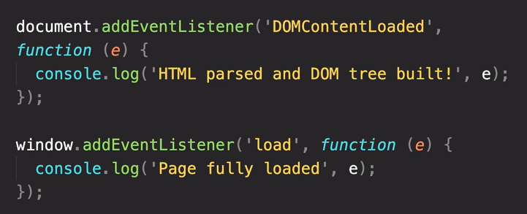
DOM Lifecycle Events
DOM lifecycle refers to sequence of events during the loading and rendering of a webpage
Key DOM Lifecycle Events :
DOMContentLoaded → Fires when the HTML document is fully parsed(does not wait for stylesheets, images)
load → Fires when the entire page, including all resources, is loaded.(wait for all external resources to finishing loading)

Slide 22
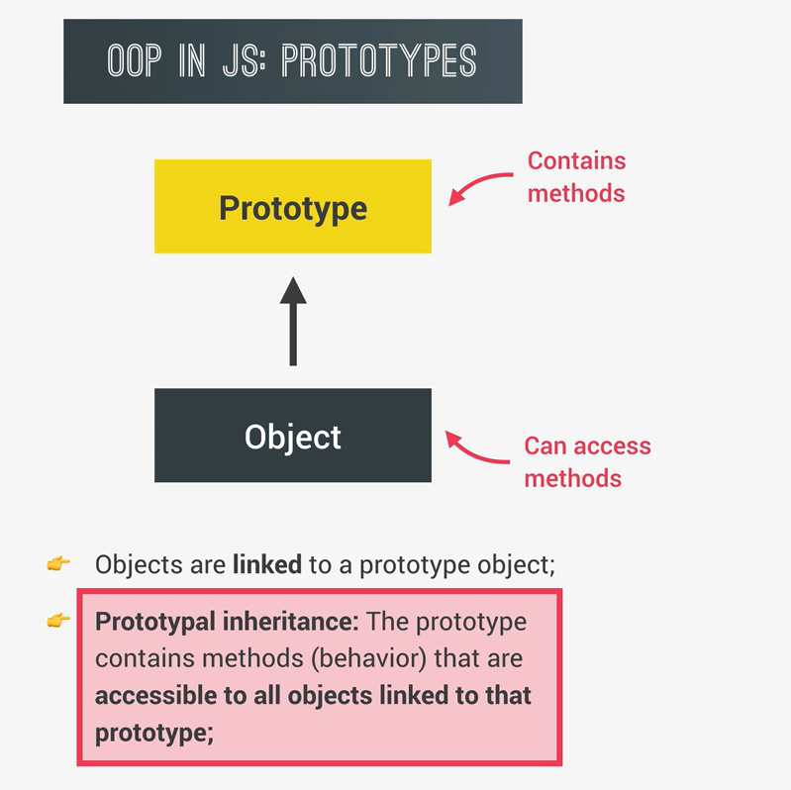
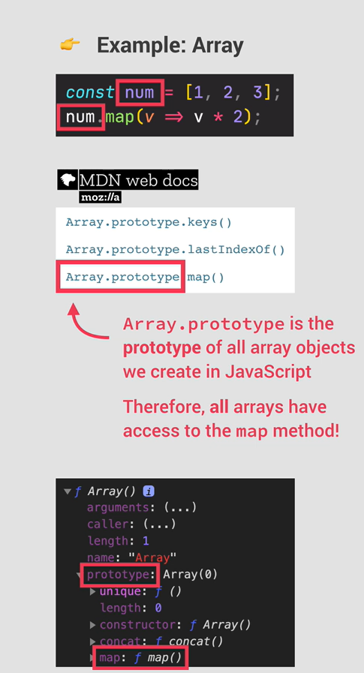
OOP in JS: Prototypes

Slide 23
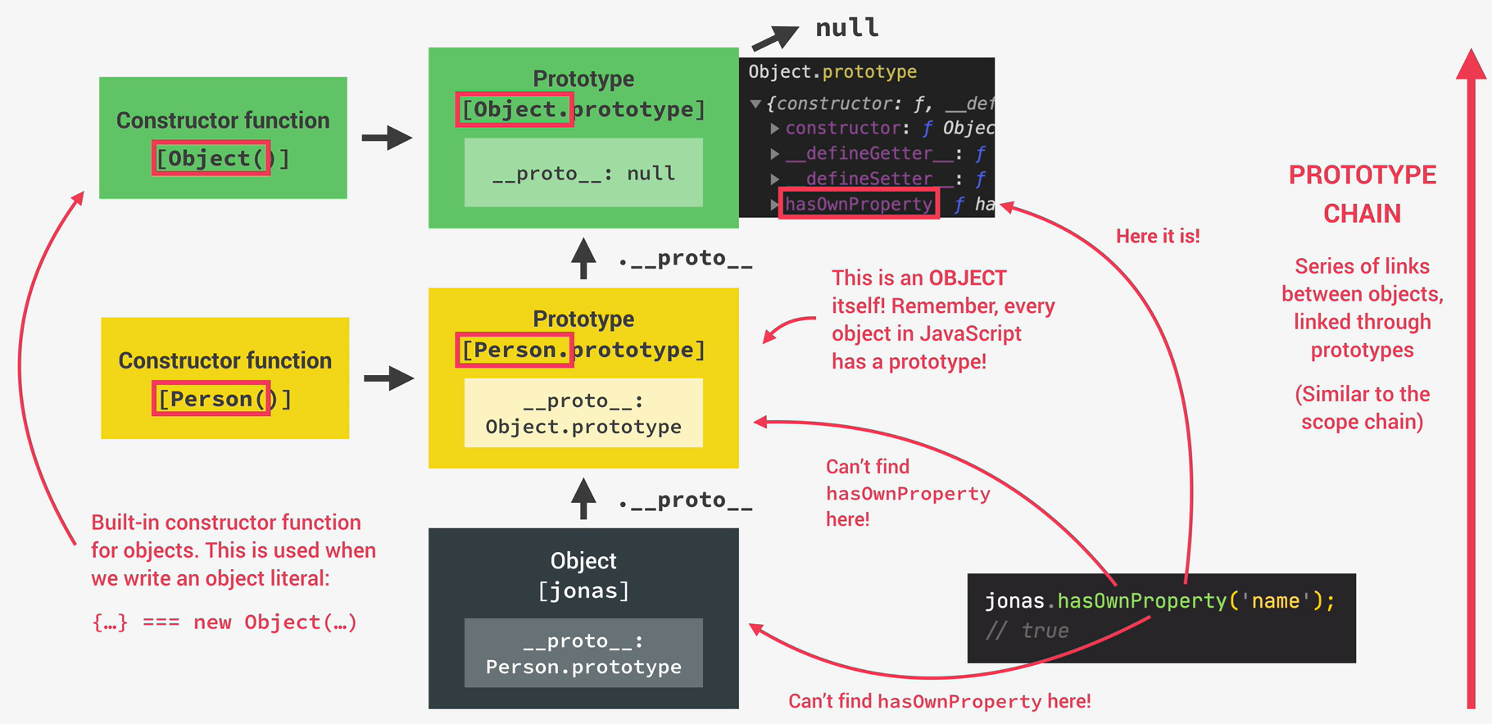
Prototype Chain

Slide 24
OOPS Conti…
Constructor, operator "new"
In JavaScript, constructor functions are a way to create and initialize objects with a specific structure and behavior.
function Dog(name, breed, age, weightinKgs) {
this.name = name;
this.breed = breed;
this.age = age;
this.weightinKgs = weightinKgs;
this.eat = function () {
console.log("Chomp");
};
}
const dogTheMarley = new Dog("Marley", "Lab", 3, 60);
Dog.prototype.smile = function(){
console.log(`${this.name} is smiling`)
}
dogTheMarley.smile() // Marley is smiling
This is how built in objects like Arrays, Maps, or Sets are actually implemented.

Slide 25
Object.create()
The Object.create() method creates a new object, using an existing object as the prototype of the newly created object.
const person = {
firstName: "John",
lastName: "Doe"
};
// Create new Object
const man = Object.create(person);
man.firstName = "Peter";

Slide 26
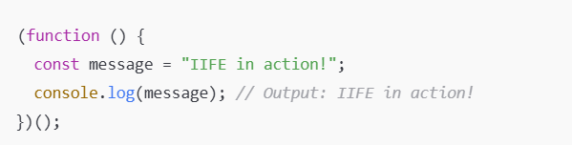
IIFE (Immediately Invoked function Expressions)
Definition: A function that runs immediately after being defined.
Syntax:
Enclose the function in parentheses to make it an expression.
Follow it with () to execute it.
Purpose:
Create a private scope.
Avoid polluting the global namespace.

Slide 27
Closures
Closures in JavaScript are a powerful feature where an inner function retains access to the variables and parameters of its outer (enclosing) function, even after the outer function has finished executing. This occurs because the inner function "remembers" the lexical environment in which it was created.
function createCounter() {
var count = 0; // 'count' is a private variable
return function() {
count++;
console.log(count);
};
}
var counter1 = createCounter();
counter1(); // Output: 1
counter1(); // Output: 2

Slide 28
Call, Apply & Bind
Definition: In JavaScript, call, apply, and bind are methods used to control the this context of a function and how arguments are passed.
Differences:
call: Immediately invokes a function, and allows you to explicitly set the this value for the function's execution and takes arguments as a comma-separated list after the this value.
apply: Similar to call but accepts arguments as an array.(useful when the number of arguments is dynamic)
bind: Does not immediately invoke the function, and Returns a new function with the this context permanently bound to a specified value. Arguments can be provided during the bind call (partial application) or when the new function is later invoked.

Slide 29
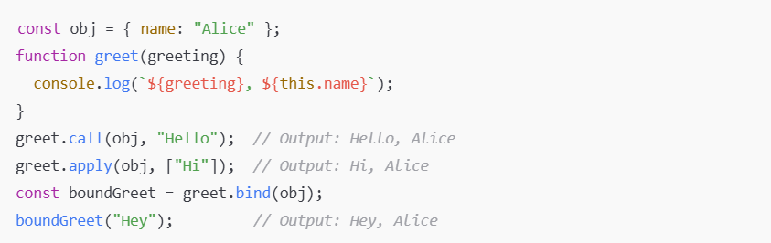
Call, Apply & Bind Cont…

Slide 30
Event Loop
Browser JavaScript execution flow, is based on an event loop.
The event loop concept is very simple. There’s an endless loop, where the JavaScript engine waits for tasks, executes them and then sleeps, waiting for more tasks.
summary of its key components and how it operates:
Call Stack: This is where synchronous JavaScript code is executed. Functions are pushed onto the stack when called and popped off when they return. JavaScript can only process one item in the call stack at a time.
Web APIs/Queue (Browser Environment) : These provide functionality for asynchronous operations like setTimeout, setInterval, fetch requests, etc. When an asynchronous operation is initiated, it's offloaded to these Queue.
When an asynchronous operation handled by Web APIs/Queue completes, it check if the call stack is empty then takes the callback from the queue and pushes it onto the call stack for execution.
This cycle repeats, allowing asynchronous operations to be handled without blocking the main thread.

Slide 31
Exercise
https://docs.google.com/document/d/197YYhjOseSsemt3PoNEQT0FxYsBLRwZYvB1o8vo4Cnw/edit?tab=t.0

Slide 32
Feedback
https://docs.google.com/forms/d/e/1FAIpQLSdvwHVFgGH-ci2xg4jga6z6FkT5rxb8jYquiw1D06ByrZNtOg/viewform?usp=publish-editor

Slide 33
Thank You

